Slide 1
SOM CLIP Steps

Slide 2
CLIP
CLIP provides interface between VHDL Code and LVFPGA Code
Two types of CLIPS
a) User Defined CLIP
b) Socketed CLIP
There can only be one socketed CLIP for each board
Notes:
Socket CLIP is the clip which defines I/O for the board
DIO’s, Voltage levels for the DIO such as LVCMOS etc.
Socketed CLIP also has timing constraints file

Slide 3
Socketed CLIP
Socketed CLIP abstracts underlying I/O for LVFPGA
It has three components
VHDL File
XML File
*.xdc or *.ucf constraints file

Slide 4
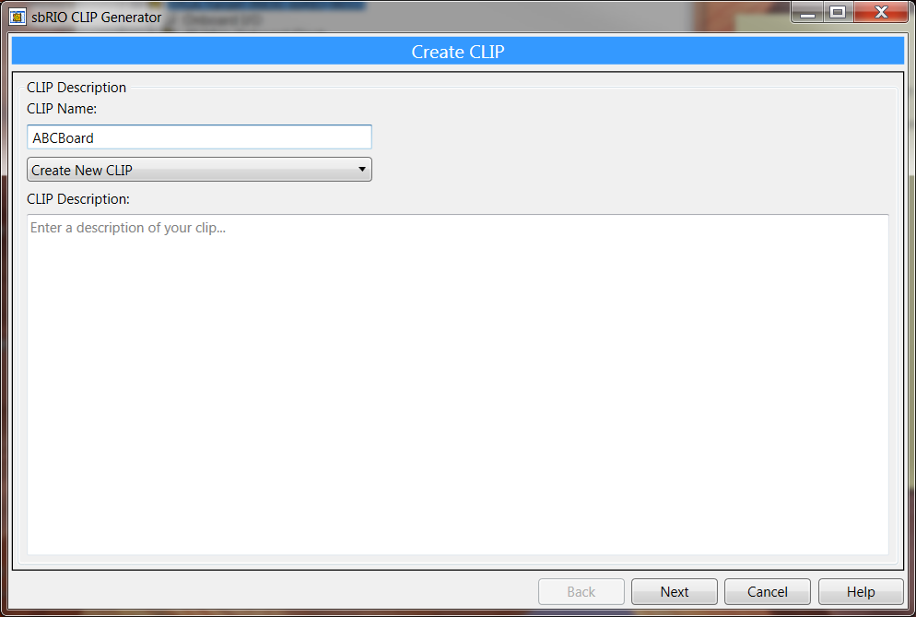
CLIP Generation Wizard
For System On Module (SOM), CLIP Generation Wizard automatically
Creates all the above 3 files with user input

Slide 5
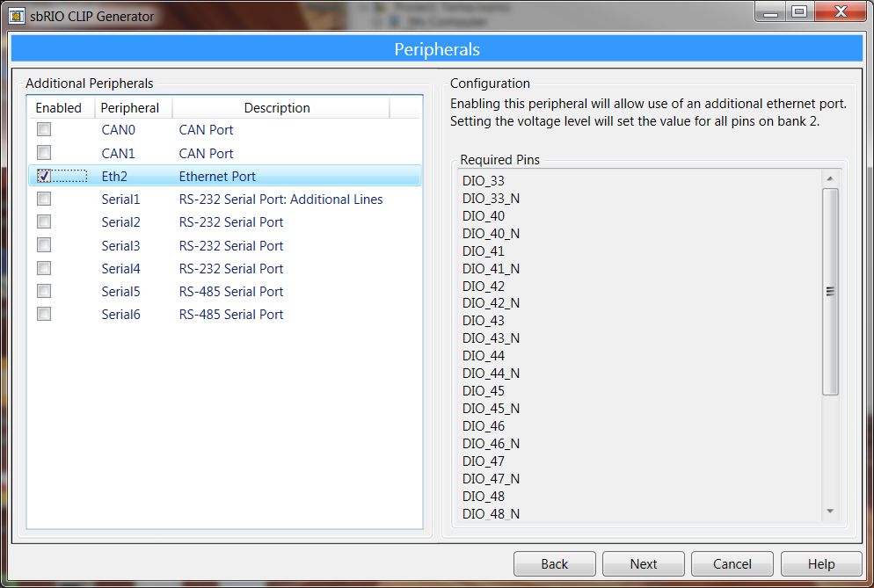
Step1: Peripherals

Slide 6
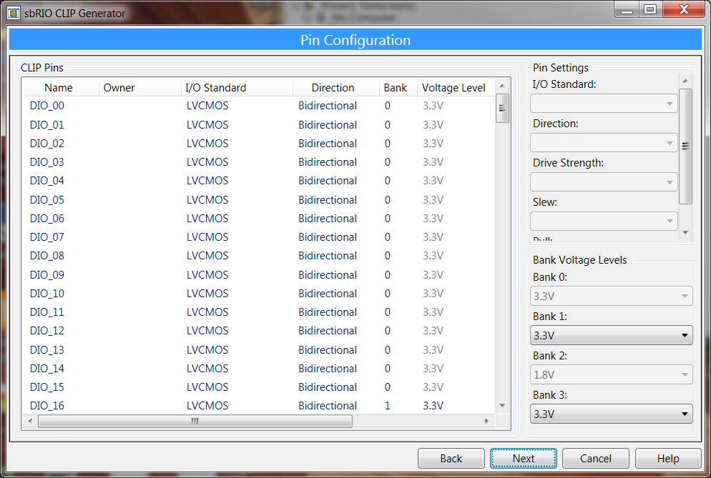
Step 2: Pin Configuration

Slide 7
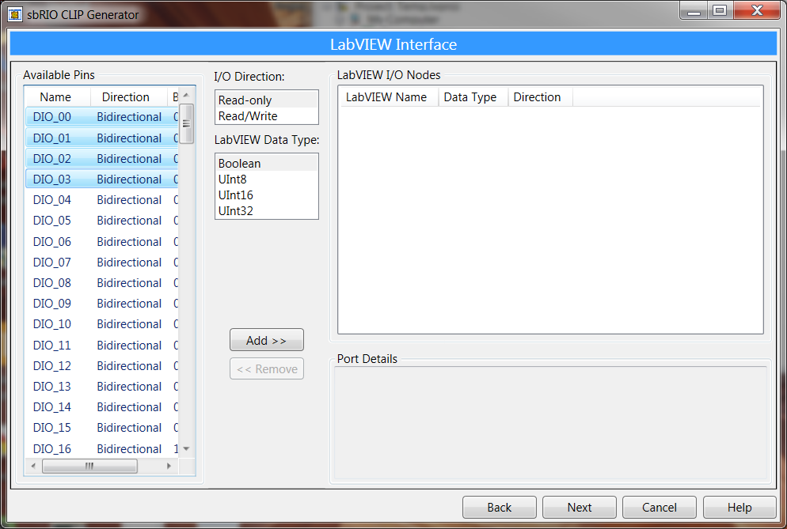
Step 3: Select Pins for LVFPGA
Notes:
You can select only the pins you are interested in programming with on LVFPGA Block diagram

Slide 8
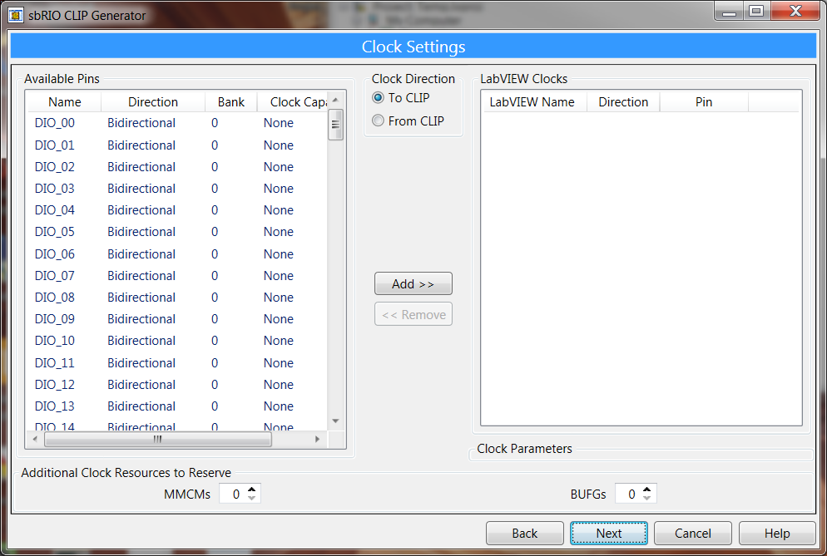
Step 3: Clocks

Slide 9
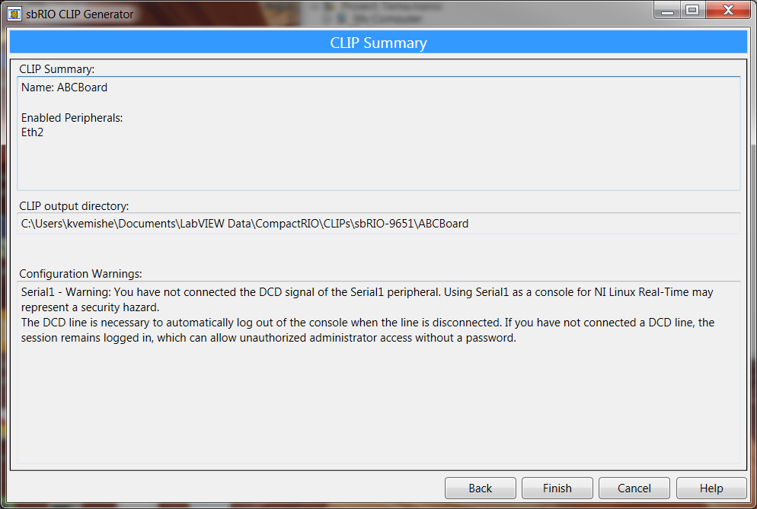
CLIP Output Directory
Clip Files

Slide 10
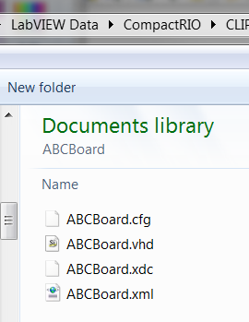
Generated Files in the directory
CLIP Wizard automatically
Generates these files normally at
…\LabVEW Data\CompactRIO\CLIPs

Slide 11
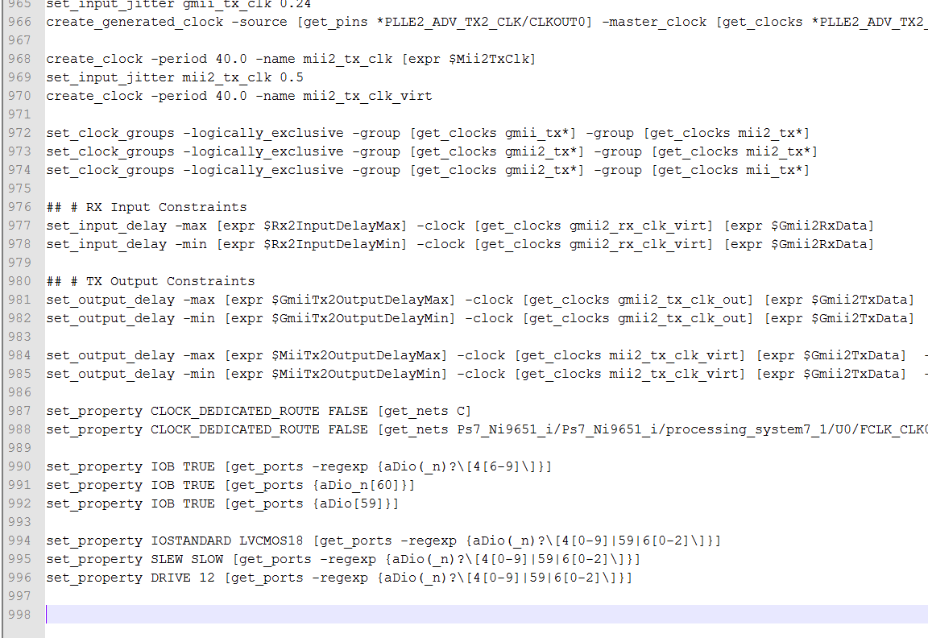
Constraints

Slide 12
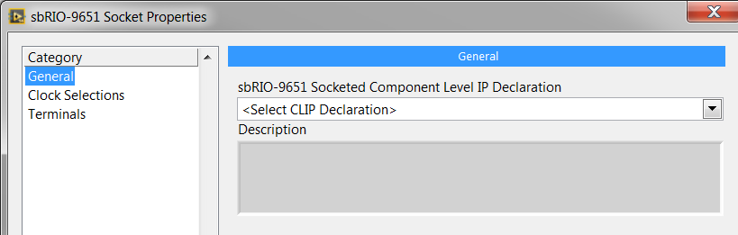
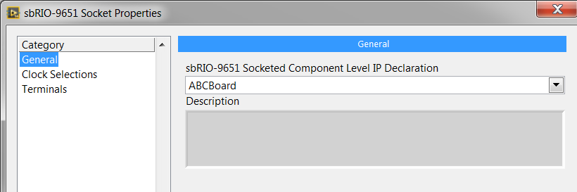
Selecting the socket for SOM

Slide 13
Demos
Create a clk in CLIP and expose it in LVFPGA
Create a clk in LVFPGA and expose it to CLIP
Exercise:
Generate two pulse with timing constraints

Slide 14
Part 2: Modifying the CLIP

Slide 15
Objectives
Generate a Clock in LVFPGA and make it available in CLIP

Slide 16
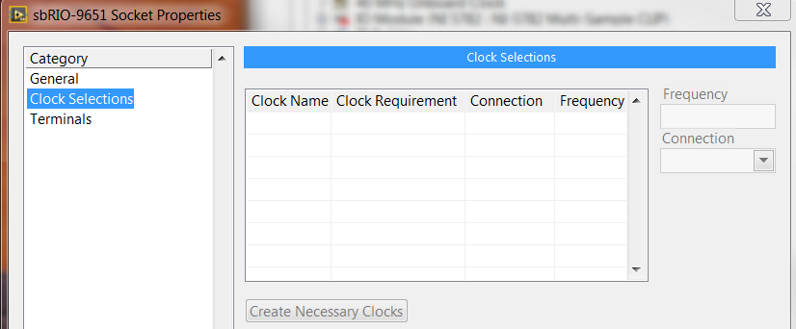
Questions
How to access LVFPGA Clocks in CLIP?
Right now, the clocks section is empty
Notes:
Right Click on Socket CLIP >> Properties >> Clock Selections

Slide 17
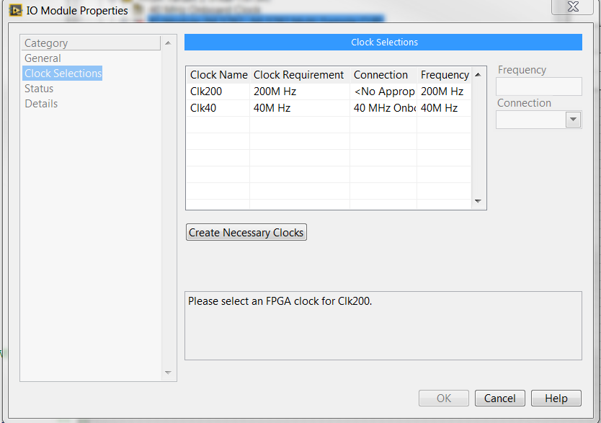
We want to see interface like this…

Slide 18
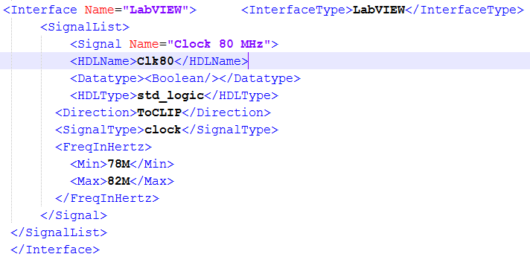
Modifying the XML File to add clock
This implies we are looking for a 80MHz clock from
LVFPGA diagram to CLIP VHDL Code

Slide 19
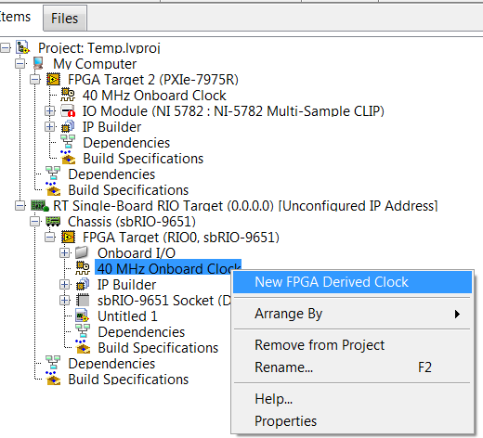
Creating Clocks in LabVIEW FPGA
Create 80MHz clock (2x Onboard Clock)

Slide 20
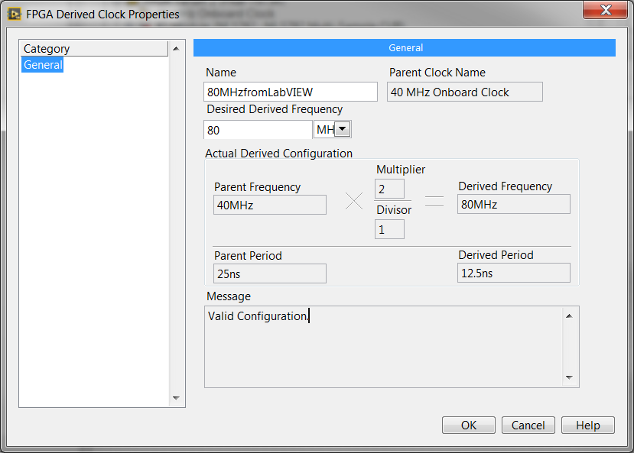
Creating Clocks in LabVIEW FPGA

Slide 21
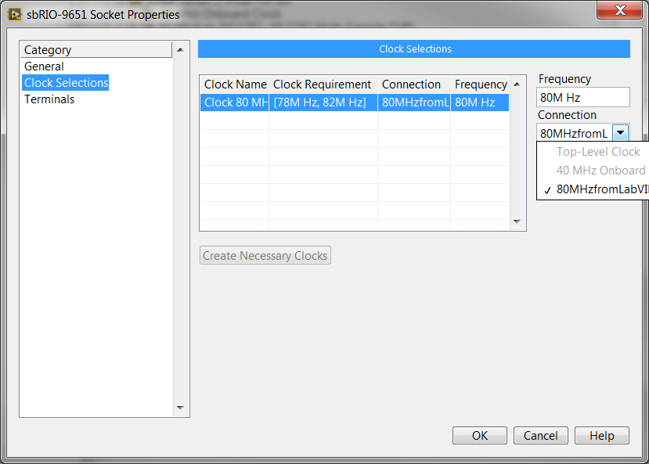
Select Clock from LVFPGA to CLIP

Slide 22
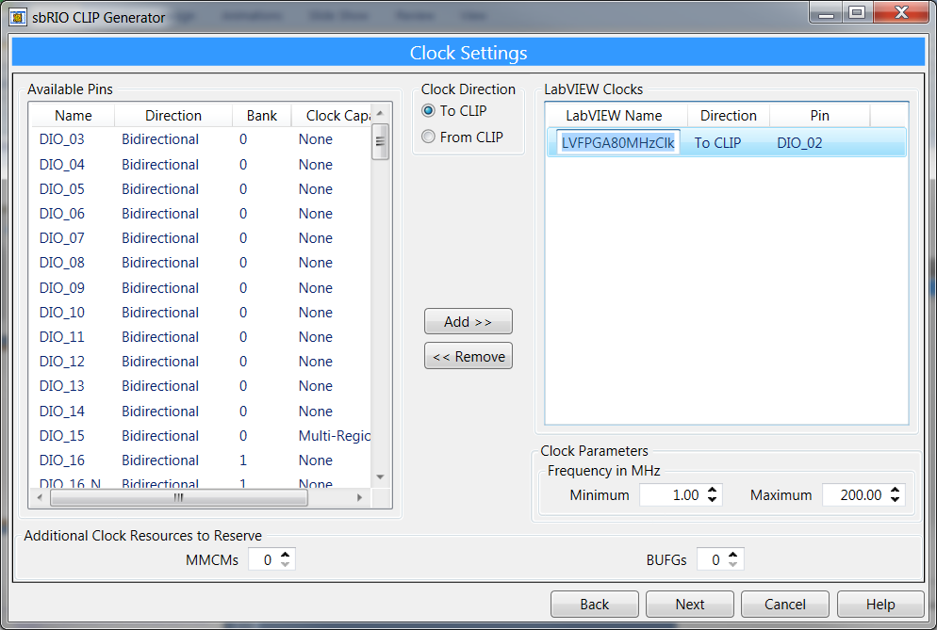
EasyTip
Clock Info

Slide 23
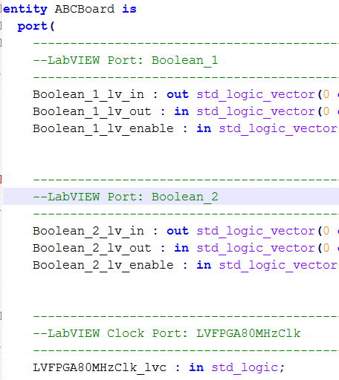
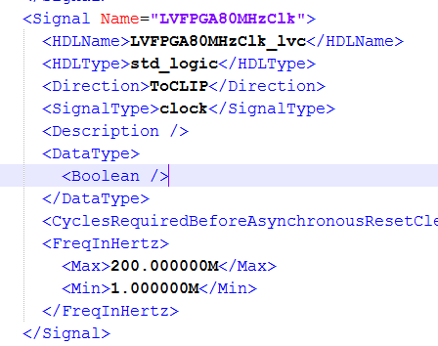
Generated Code
Generated XML Code
Generated VHDL Code

Slide 24
End of Part 2

Slide 25
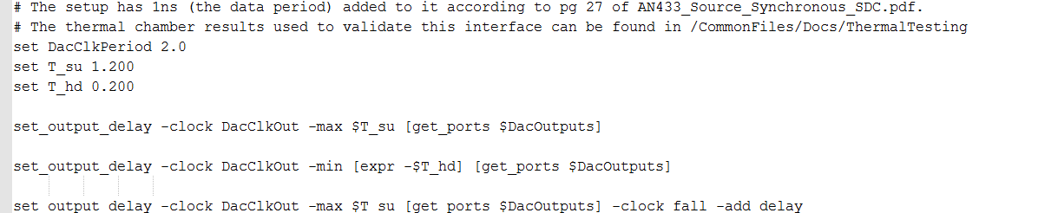
Timing Constraints
I would encourage looking at the VHDL and XML files
for our FlexRIO adapter modules such as 5781, 5761

Slide 26
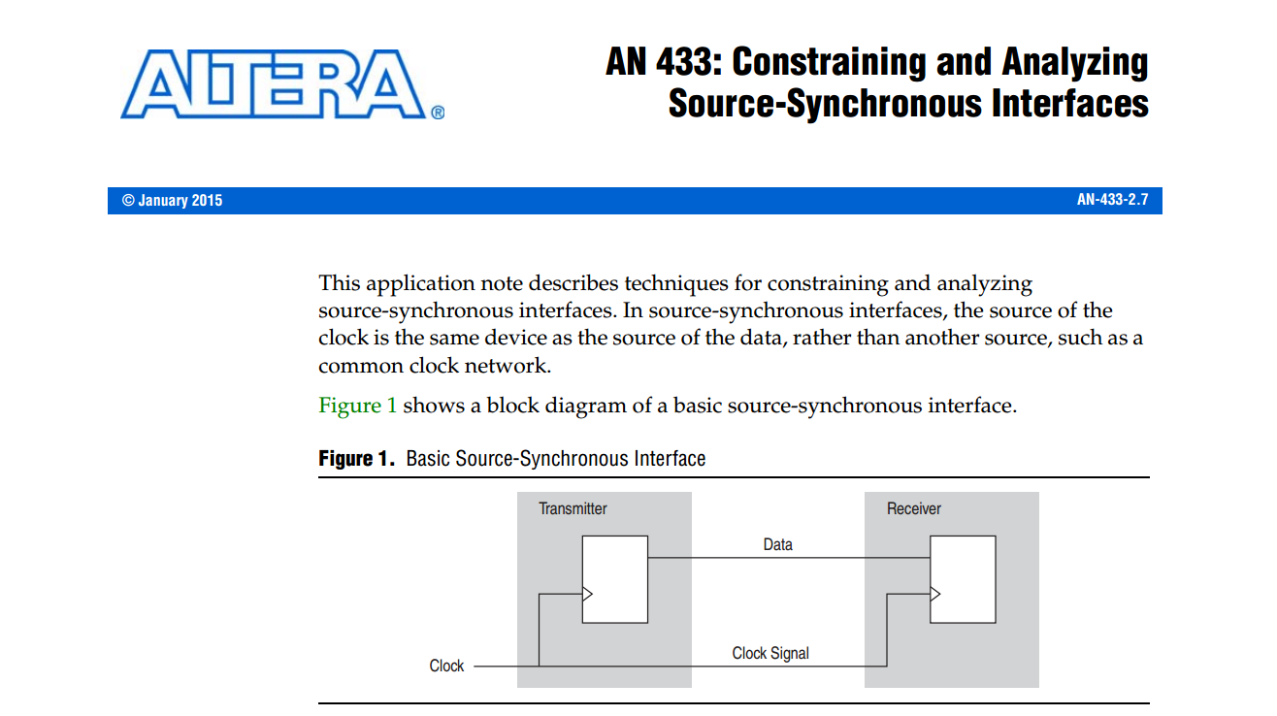
Timing Constraints Document
https://www.altera.com/content/dam/altera-www/global/en_US/pdfs/literature/an/an433.pdf
Search for AN433 source synchronous document

Slide 27
Questions
How do you people access clocks in the CLIP?

